Slide 1
Dot Net Framework

Slide 2
What is Framework?
In software development, a Framework is a defined support structure in which another software project can be organized and developed. Typically, a framework may include support programs, code libraries and a scripting language amongst other software to help develop and glue together the different components of your project.

Slide 3
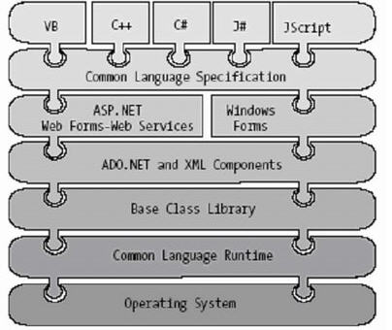
Basic Framework

Slide 4
The most important features of .NET
Assemblies
Metadata
Common Type System
Common Intermediate Language
Common Language Runtime
Deploying .NET Runtime
Garbage Collection
Serialization

Slide 5
.NET Benefits
In comparison with previous Microsoft’s technologies:
Simplified programming model – no error codes
Run once, run always – no "DLL hell"
Simplified deployment – easy to use installation projects
Wide platform reach
Programming language integration
Simplified code reuse
Automatic memory management (garbage collection)
Rich debugging support – CLR debugging, language independent
Consistent method failure paradigm – exceptions
Security – code access security
Interoperability – using existing COM components, calling Win32 functions

Slide 6
.NET Programming Languages
Examples:
C#
Managed Extensions for C++
Java - Visual J# .NET
JavaScript - JScript .NET
Perl
Pascal, Delphi
PHP
Smalltalk

Slide 7
Common Language Runtime (CLR)

Slide 8
Managed Module
A managed module is a standard 32-bit Microsoft Windows portable executable (PE32) file or a standard 64-bit Windows portable executable (PE32+) file that requires the CLR to execute.
Parts of a Managed Module
  PE32 or PE32+ header - If the header uses the PE32 format, the file can run on a 32-bit or 64-bit version of Windows. If the header uses the PE32+ format, the file requires a 64-bit version of Windows to run. This header also indicates the type of file: GUI, CUI, or DLL, and contains a timestamp indicating when the file was built.
  CLR header - Contains the information that makes this a managed module. The header includes the version of the CLR required, some flags, the MethodDef metadata token of the managed module’s entry point method (Main method), and the location/size of the module’s metadata, resources, strong name, some flags, etc.
  Metadata - Every managed module contains metadata tables. There are two main types of tables: tables that describe the types and members defined in your source code and tables that describe the types and members referenced by your source code.
  IL code - Code the compiler produced as it compiled the source code.

Slide 9
Use of Managed Module
Removes the need for native C/C++ header and library files
IntelliSense feature
Code verification process for type-safe operations
Allows an object’s fields to be serialized into a memory block
Track for Garbage Collection

Slide 10
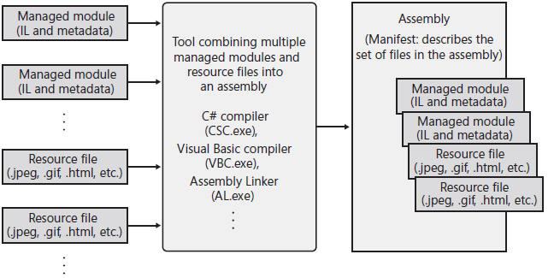
Assemblies
First, an assembly is a logical grouping of one or more modules or resource files. Second, an assembly is the smallest unit of reuse, security, and versioning.

Slide 11
Assembly Manifest
Manifest is a piece of metadata which describes the assembly
itself
Manifest documents all external assemblies required by the
current assembly to function correctly
Content of a manifest:
  the name of the assembly
  the version of the assembly
the shared name for the assembly
information about the type of environment the assembly
supports (e.g. operating system and languages)
list of files in the assembly
list of all other assemblies this assembly references

Slide 12
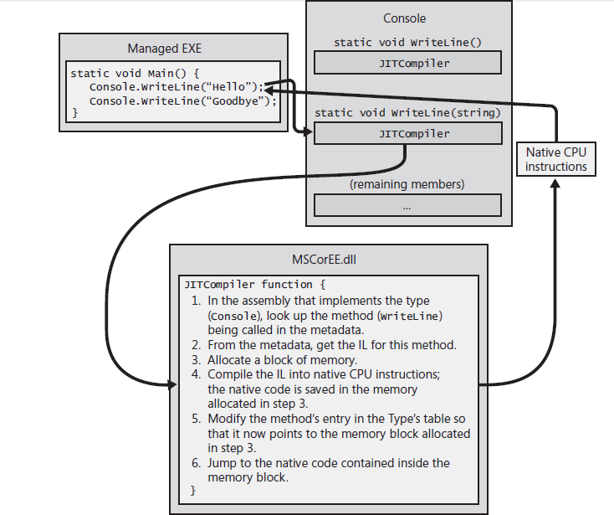
First Execution

Slide 13
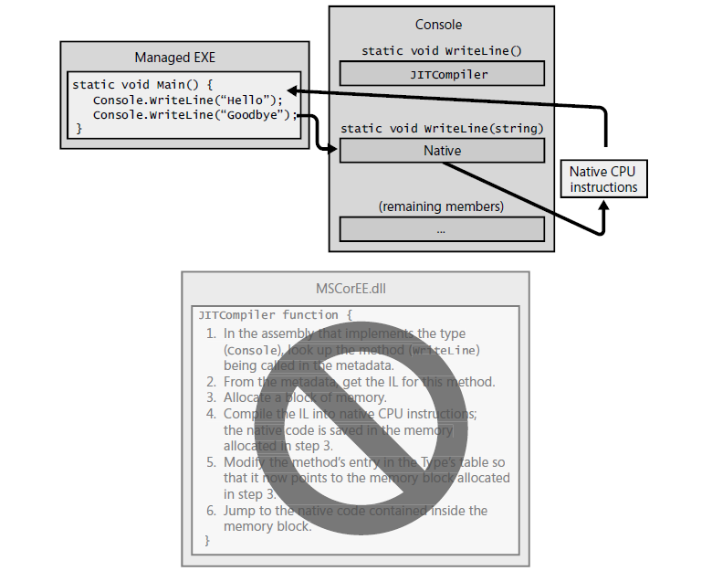
Later Executions

Slide 14
Single-File and Multifile Assemblies
In a great number of cases, there is a simple one-to-one
correspondence between a .NET assembly and the binary file
(.dll or .exe)
this is single-file assembly
Multifile assemblies are composed of numerous .NET binaries
(modules)
􀂄 one of these modules (primary module) must contain the
assembly manifest
􀂄 multifile assemblies allow to use more flexible deployment
option (e.g. the user is forced to download only selected
modules)

Slide 15
Private Assemblies
Private assemblies are required to be located in application’s directory or subdirectory
Identification of a private assembly:
name of the module that contains the assembly’s manifest
(without an extension)
version number

Slide 16
Shared Assemblies
Single copy of a shared assembly can be used by several
applications on a single machine
A shared assembly should be installed into the Global
Assembly Cache (GAC), located in Assembly subdirectory
of Windows directory
since VS 2005 also *.exe files can be installed into the GAC
(previously only *.dll files were accepted)
To list content of the GAC, install a new assembly, or
uninstall an assembly, use gacutil.exe utility
installing an assembly:
gacutil.exe –i MyAssembly.dll
Two or more assemblies of the same name can coexist in
the GAC (must have different versions)
the end of "DLL hell"

Slide 17
Signing an Assembly
Only assemblies signed using a strong name can be installed into the GAC
Signing an assembly:
1. Use the sn.exe utility to generate a .snk file with public/private key information
sn –k MyKey.snk
2. Apply the .snk file to the assembly (using
AssemblyKeyFile attribute or by setting project’s properties in Visual Studio)
3. Compile the assembly

Slide 18
JIT Compiler
Compiles the IL code into native code
A JIT compiler can determine whether or not to generate any CPU instructions, eg :
if (numberOfCPUs > 1) { … }
Responsible for address track of the stored native code
Alternate is to use NGen.exe to avoid JIT compilation

Slide 19
IL(MSIL) and Verification
Verification examines the high-level IL code and ensures that everything the code does is safe.
Robustness Via Separate Address space and reducing number of process to be created.
Responsible for address track of the stored native code.
/unsafe switch and System.Security.Permissions.SecurityPermissionFlag’s SkipVerification
PEVerify.exe – to check unsafe code

Slide 20
NGen(Native Code Generator)
Native code generated on installation/shipment time.
New file is placed in a folder under the directory with a name like C:\Windows\Assembly\NativeImages_v4.0.#####_32.
Advantages
  Faster execution on first time
  Reducing Application’s working set – Memory mapped into multiple process address space

Slide 21
Prefer NGen?.. No
No Intellectual
Can get out of Sync – CLR Version, CPU Type, MVID, Referenced Assemblies Version IDs, Security Changes.
Inferior Execution Performance – Static field access, unable to determine address, calling constructors.

Slide 22
Common Type System (CTS)
Types in .NET
classes (sealed classes, implementing interfaces, abstract classes, internal or public classes)
structures
interfaces (named collections of abstract member definitions)
enumerations
delegates (equivalent of type-safe function pointer)
CTS is a formal specification that documents how types must be defined in order to be hosted by the CLR

Slide 23
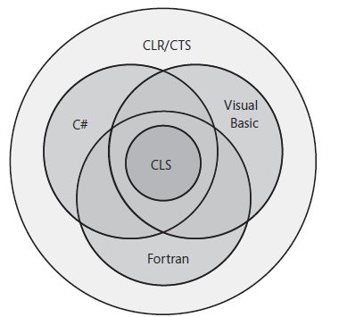
Common Language Specification (CLS)
Common Language Specification (CLS) that details for compiler vendors the minimum set of features their compilers must support if these compilers are to generate types compatible with other components

Slide 24
CLS, an Example
using System;
// Tell compiler to check for CLS compliance
[assembly: CLSCompliant(true)]
namespace DotNetFrameworkDemo
{
// Warnings appear because the class is public
public sealed class ClsCompliantDemo
{
// Warning: Return type of 'SomeLibrary.SomeLibraryType.Abc()'
// is not CLS-compliant
public UInt32 Abc() { return 0; }
// Warning: Identifier 'SomeLibrary.SomeLibraryType.abc()'
// differing only in case is not CLS-compliant
public void abc() { }
// No warning: this method is private
private UInt32 ABC() { return 0; }
}
}

Slide 25
More on CLS
Everything treated as field (data) or a method (behavior).
using System;
namespace ClsDemo
{
internal sealed class Test
{
// Constructor
public Test() { }
// Finalizer
~Test() { }
// Operator overload
public static Boolean operator ==(Test t1, Test t2) { return true; }
public static Boolean operator !=(Test t1, Test t2) { return false; }
// An operator overload
public static Test operator +(Test t1, Test t2) { return null; }
// A property
public String AProperty { get { return null; } set { } }
// An indexer
public String this[Int32 x] { get { return null; } set { } }
}
}

Slide 26
More on CLS
Everything treated as field (data) or a method (behavior).
using System;
namespace ClsDemo
{
internal sealed class Test
{
// Constructor
public Test() { }
// Finalizer
~Test() { }
// Operator overload
public static Boolean operator ==(Test t1, Test t2) { return true; }
public static Boolean operator !=(Test t1, Test t2) { return false; }
// An operator overload
public static Test operator +(Test t1, Test t2) { return null; }
// A property
public String AProperty { get { return null; } set { } }
// An indexer
public String this[Int32 x] { get { return null; } set { } }
}
}

Slide 27
Common Type System (CTS)
Types in .NET
classes (sealed classes, implementing interfaces, abstract classes, internal or public classes)
structures
interfaces (named collections of abstract member definitions)
enumerations
delegates (equivalent of type-safe function pointer)
CTS is a formal specification that documents how types must be defined in order to be hosted by the CLR

Slide 28
Intrinsic CTS Data Types
CTS Data Type | VB.NET | C# | Managed C++
System.Boolean | Boolean | bool | Bool
System.Decimal | Decimal | decimal | Decimal
System.String | String | string | String^
System.Char | Char | char | wchar_t
System.Object | Object | object | Object^
System.Double | Double | double | Double
System.Single | Single | float | Float

Slide 29
Deploying .NET Runtime
.NET assemblies can be executed only on a machine that has the .NET Framework installed
.NET Framework 1.1 was included in Windows Server 2003
and was an optional component of Windows XP Service Pack 1
Redistributable packages (dotnetfx.exe)
.NET Framework 1.1
  23.1 MB
  Windows 98/Me/NT/2000/XP/2003, IE 5.01
.NET Framework 2.0
  22.4 MB
  Windows 98/Me/NT/2000/XP SP2/2003, IE 5.01
  Windows Installer 3.0
  disk space: 280 MB (x86), 610 MB (x64)

Slide 30
Garbage Collection (GC)

Slide 31
Object Management
Allocate memory for the type that represents the resource using newobj instruction of IL, initialize managed heap and NextObjPtr.
Initialize the memory to set the initial state of the resource
Use the resource by accessing the type’s members
Tear down the state of a resource to clean up.
Free the memory(Garbage Collection)

Slide 32
Memory Allocation(newobj)
Calculate the number of bytes required for the type.
Add the bytes required for an object’s overhead(+8/+16 bytes)
Check if memory size is available
If yes, the type’s constructor is called (passing NextObjPtr for the this parameter), and the newobj IL instruction (or C#’s new operator) returns the address of the object. Just before the address is returned, NextObjPtr is advanced past the object
Else(NextObjPtr + new object’s size), Call garbage collection.

Slide 33
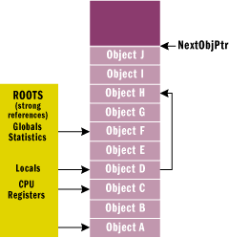
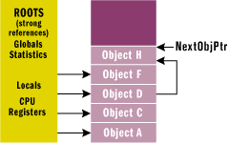
How GC Works?
As the JIT compiler produces the native code, it also creates an internal table, with all roots and its references.
Graphs of Root and its References are created

Slide 34
Forcing a Garbage Collection
Sample scenarios when forcing a garbage collection can be useful:
the application is about to enter a block of code which should not be interrupted
the application has just finished allocating an extremely large
number of objects and as much memory as possible should be
freed
GC.Collect();
GC.WaitForPendingFinalizers();

Slide 35
Disposable Objects
public class MyClass : IDisposable
{
public void Dispose()
{
// here dispose all memory
// - all unmanaged resources
// - call Dispose() method of all contained
// disposable objects
}
}
using (MyClass mc = new MyClass()) {
// ... using mc object
} // here Dispose() method is called automatically

Slide 36
Serialization
Serialization is a process of persisting (and possibly
transferring) the state of an object to a stream
The persisted data sequence contains all necessary information needed to reconstruct (deserialize) the state of the object
When an object is persisted to a stream, all associated data (base classed, contained objects, etc.) are automatically serialized as well
It allows to persist an object graph in a variety of formats
Full set of related objects (so-called object graph) is serialized
All objects in an object graph to serialize must be marked with the [Serializable] attribute
Formatters available in .NET 2.0:
􀂄 BinaryFormatter – compact binary format
􀂄 SoapFormatter – SOAP message
􀂄 XmlFormatter – XML document

Slide 37
History
Next Generation Windows Services, late 90s
.NET Framework 1.0, 05.01.2002
.NET Framework 1.1, 01.04.2003
  Bug fixes + API changes
  .NET Compact Framework
.NET Framework 2.0, 07.11.2005
  Bug fixes + API changes
  Full 64 bit support
  Language support for generics
  New controls

Slide 38
Thank You

